Slide 1

Career Guidance Tool R Shiny App
Divya Garg
Edwin Odugba
Noble Joy

Slide 2
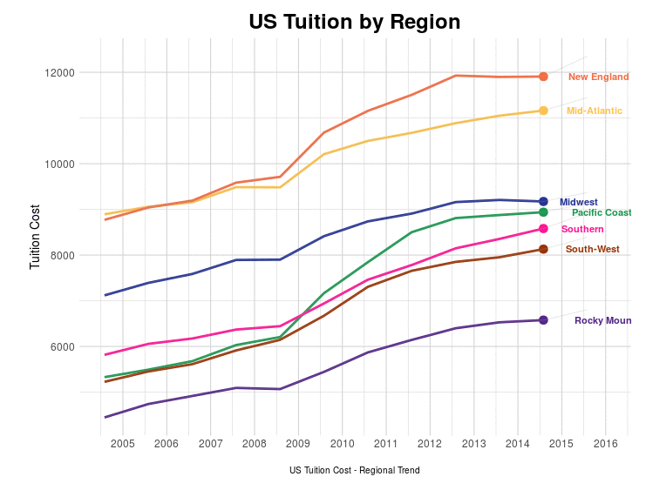

Quick Recap from Design Contest

Slide 3


Key Questions Asked
What is the best course to study?
Which university to should choose?
How to compare Cost of education?
What is the expected earnings for any selected course?
What are the Top Courses in US based on earnings?
What are the Top Colleges in US for Computer Science?
Which Couse has the best return on investment ?
What are the best options in my state ?
How can I compare Stanford & Cornell ?

Slide 4

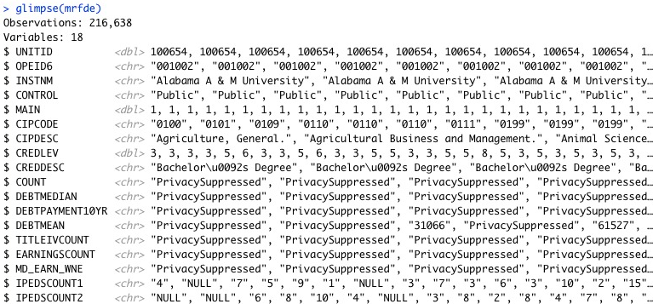
Dataset
U.S. DEPARTMENT OF EDUCATION - College Scorecard - https://collegescorecard.ed.gov/data/
Columns
Institution Id/Name
City/State/Zip
Region
Latitude/Longitude
Cost
Course & Degree
Earning
Cost to Earning Ratio
Rank

Slide 5

R Shiny Implementation
Libraries used –
library(shiny)
library(data.table)
library(maps)
library(ggplot2)
library(tidyverse)
library(ggrepel)
library(scales)
library(DT)
library(plotly)
library(leaflet)
Methods used –
Select
Mutate
Gather
Transform
Filter
Inner_Join
Technical Challenges–
App Layout
Map
App Interaction
Reports used –
Map
Table
Bar graph
App details –
https://edwinodugba.shinyapps.io/finalproj/
https://github.com/eodugba/dsba5122_FinalProject

Slide 6
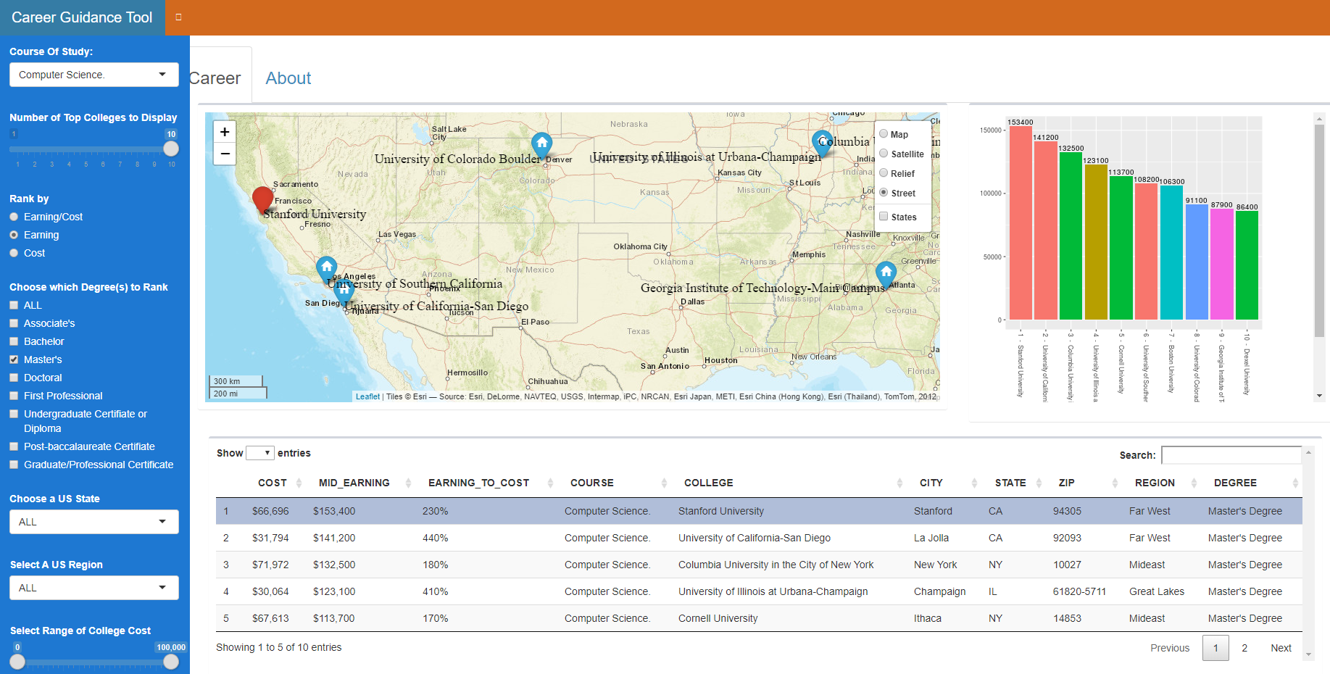
R Shiny Implementation
Top 10 Computer Science Masters Programs in US ranked by Earning

Slide 7
Future Enhancements
Include Cost details for each course stream
Include projected number of jobs for each course stream
Include unemployment rates for each course stream
Include data for MOOC - Massive Open Online Courses
EdX
Coursera
Khan Academy
Udemy
Udacity
FutureLearn
Support Job Search

Slide 8

Our Goal
Help Clients fulfill their dream by assisting them find their best career choice
Helps clients think outside the box
Rate options by comparing their preferred choices
Our Clients includes Students, Parents and the Community of people looking to learn something new to switch their careers

Slide 9

Questions

